Slide 1
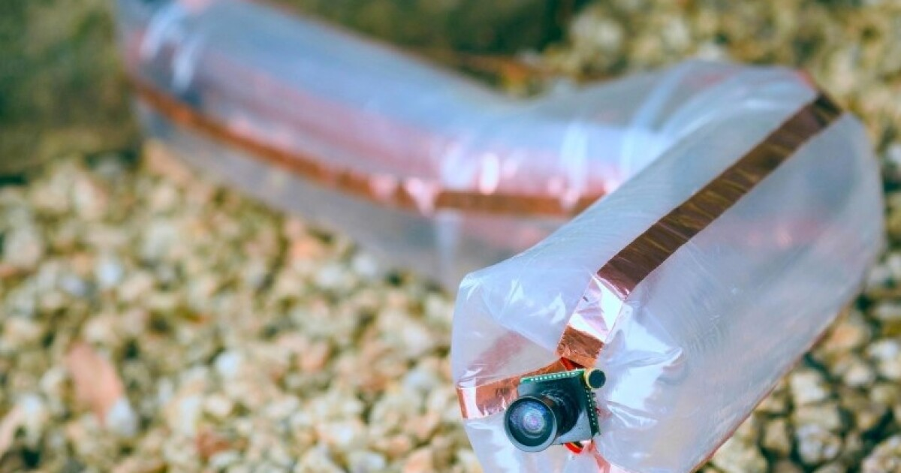



Apical Robotics
Vine Robots for Industrial Inspection
Fall 2022 Final Presentation

Slide 2
Presentation Structure
Introduction
Modeling
Prototype 1
Testing Results
Conclusion

Slide 3
Presentation Structure
Introduction
Modeling
Prototype 1
Testing Results
Conclusion
Introduction
Modeling
Prototype 1
Testing Results
Conclusion

Slide 4
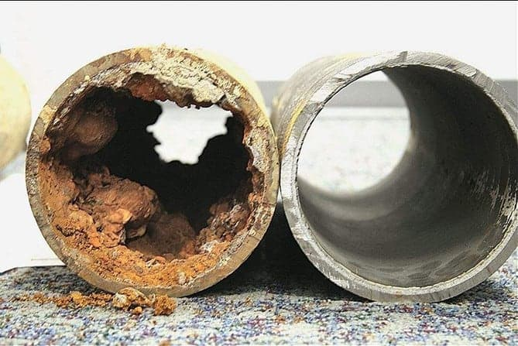
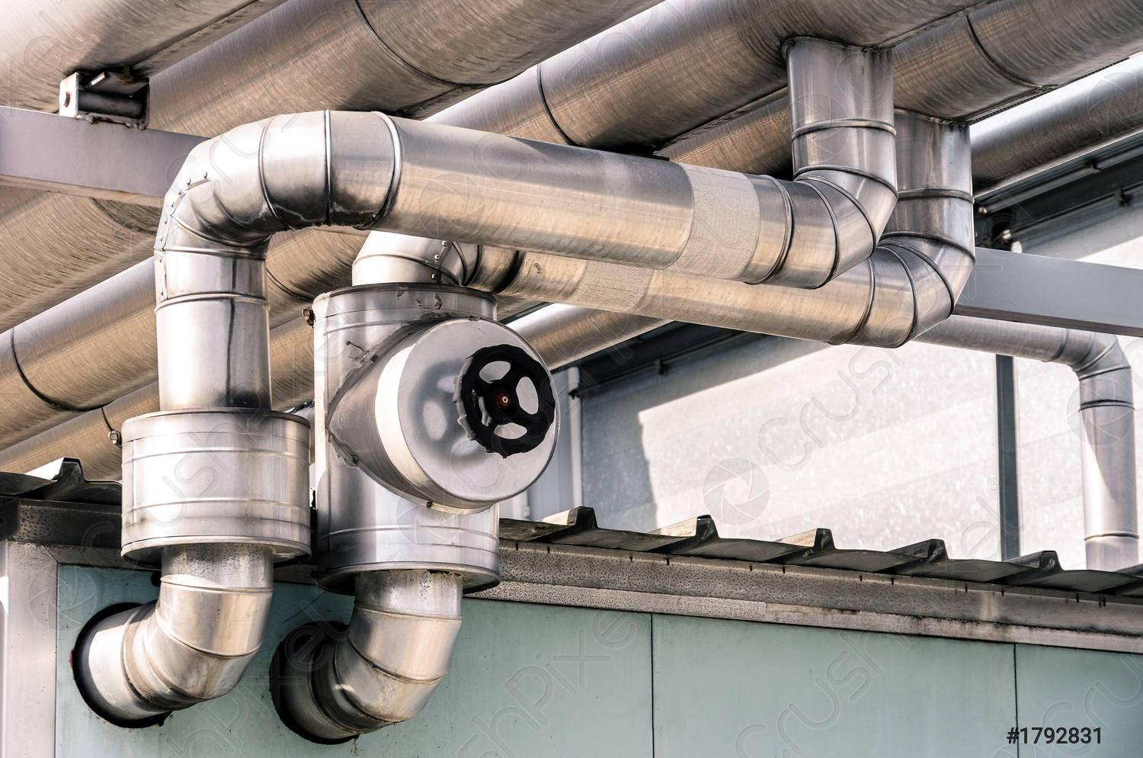
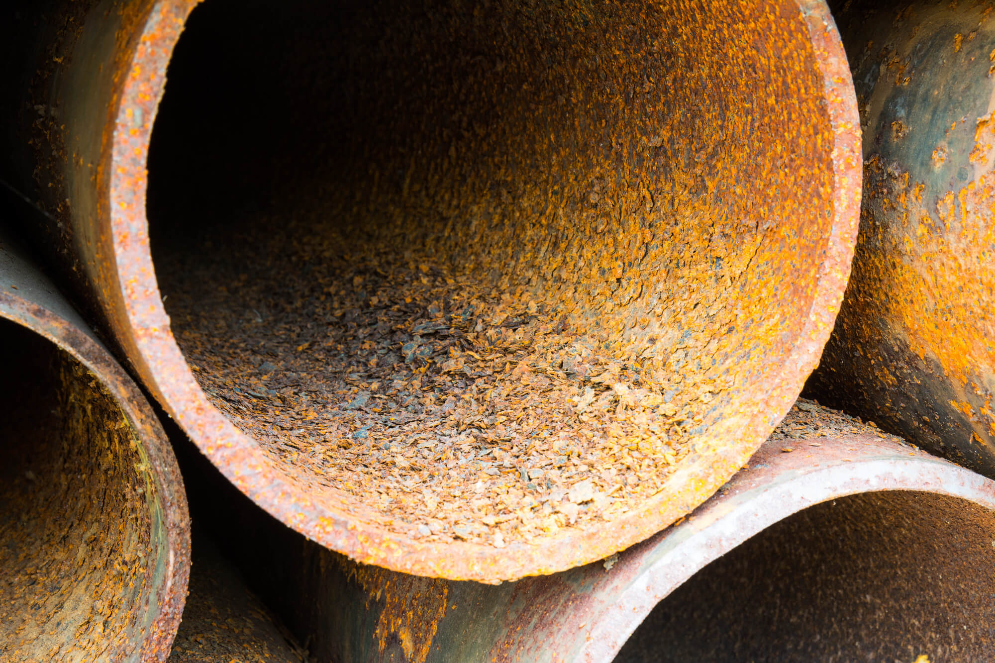
Industrial Pipe Inspection
Industrial pipes are inspected during maintenance or after installation
Blockage
Structural Damage
Introduction
Modeling
Prototype 1
Testing Results
Conclusion

Slide 5
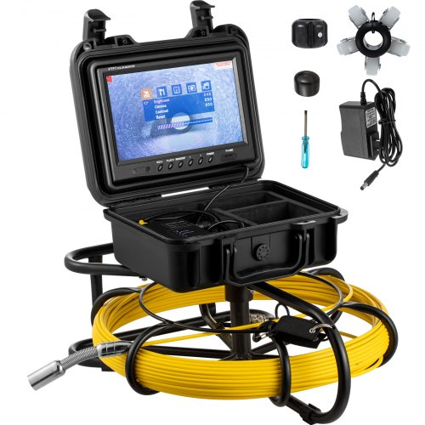
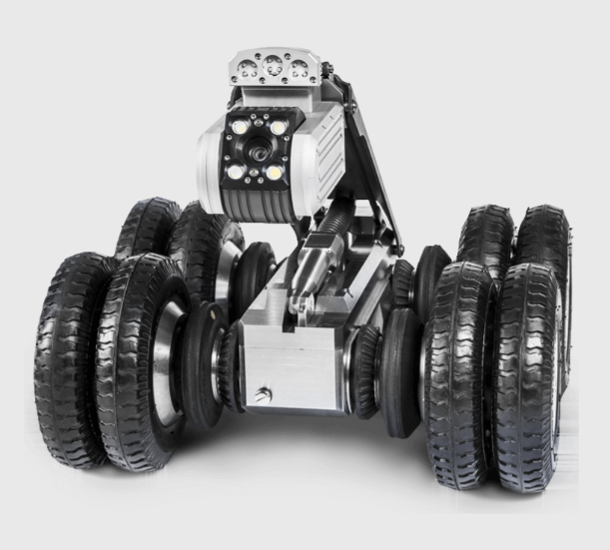
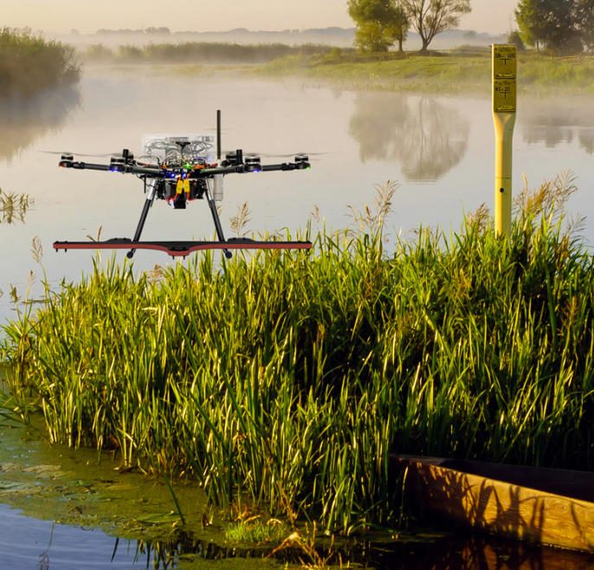
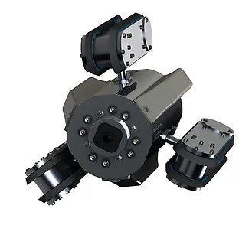
Industrial Inspection Challenges
Borescope (Vevor)
Wheeled robot (Fiberscope)
Four fundamental limitations of existing technologies:
Vertical pipe sections
Changes in pipe diameter
Turns
Long pipe sections
Drone (Inspector X GmbH)
Tracked robot (In-pipe Robotics)
Introduction
Modeling
Prototype 1
Testing Results
Conclusion

Slide 6

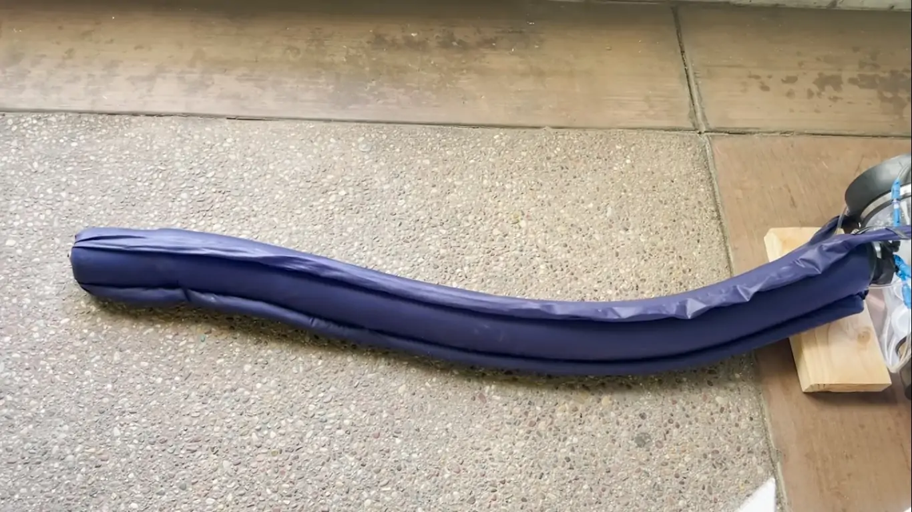
Vine Robots for Industrial Pipe Inspection
We plan to use a soft, continuum robot known as a "vine robot" for industrial pipe inspection
Heap et. al.
Introduction
Modeling
Prototype 1
Testing Results
Conclusion

Slide 7
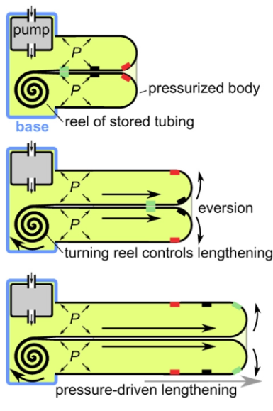

Working Principle of Vine Robots
Vine robots work by pressurizing a soft tube that is inverted into itself
Hawkes et. al.
Introduction
Modeling
Prototype 1
Testing Results
Conclusion

Slide 8
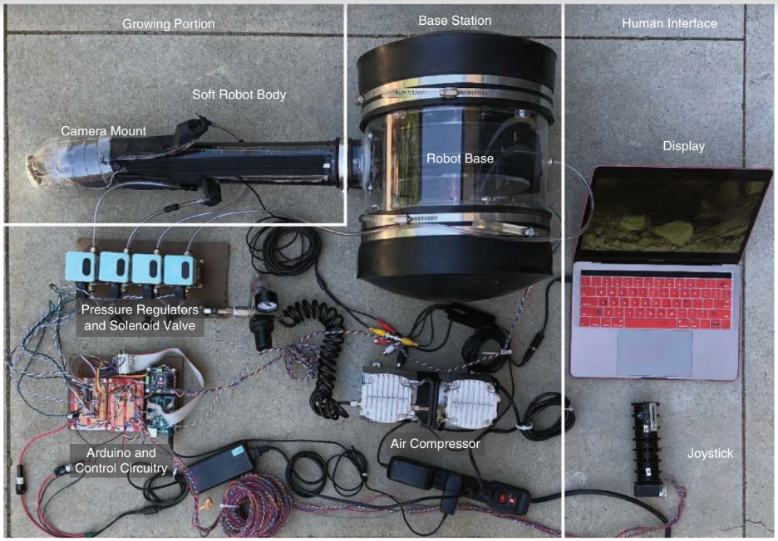
Vine Robot Subsystems
Coad et. al.
Introduction
Modeling
Prototype 1
Testing Results
Conclusion

Slide 9
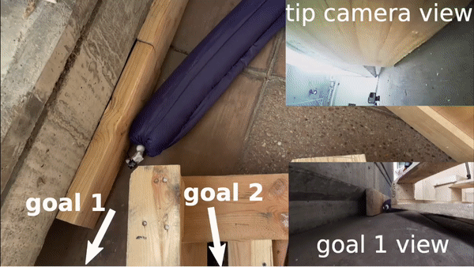
Vine Robot Advantages for Pipe Inspection
Light, compliant body with small minimum diameter
Low-friction locomotion without sliding against the environment
Ability to apply significant force to pull a tether at its tip
  This leads to successful growth through turns, vertical sections, and sections with changing diameters
Heap et. al.
Introduction
Modeling
Prototype 1
Testing Results
Conclusion

Slide 10
Bechtel Corp. Research Funding
Given vine robot’s advantages, Bechtel Corp. funded research for a proof of concept for the following task
3’
Increased diameter
Long vertical section
40’
90 degree long-radius elbow
Access Point
120’
3’
Introduction
Modeling
Prototype 1
Testing Results
Conclusion

Slide 11
Our Solution
Grow and retract a vine robot through the pipe with a camera transmitting a live video feed
Camera mount at the tip
Base station
Pipe
Introduction
Modeling
Prototype 1
Testing Results
Conclusion

Slide 12
Concept Selection - Vine Robot Diameter
Same Dimensions
Potentially less likely to fail
Simpler modeling
Lower burst pressure
Smaller Dimensions
Simpler to build
Smaller and lighter
More failure modes
More complex modeling
Introduction
Modeling
Prototype 1
Testing Results
Conclusion

Slide 13
Presentation Structure
Introduction
Modeling
Prototype 1
Testing Results
Conclusion
Introduction
Modeling
Prototype 1
Testing Results
Conclusion

Slide 14
Modeling Goals
Derive hoop stress and tensile stresses
Find safety factors using yield stress
Use results to inform diameter/concept selection
Introduction
Modeling
Prototype 1
Testing Results
Conclusion

Slide 15
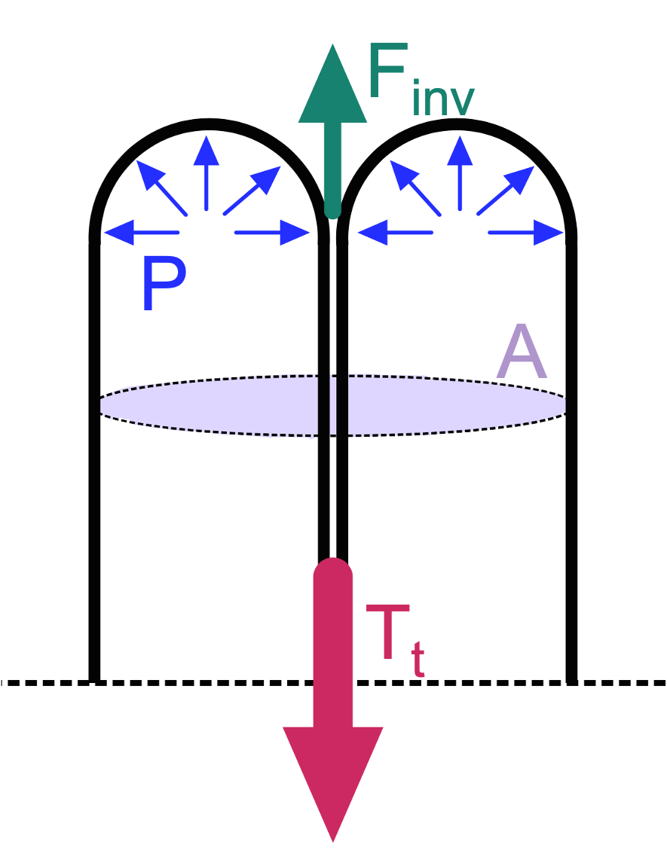
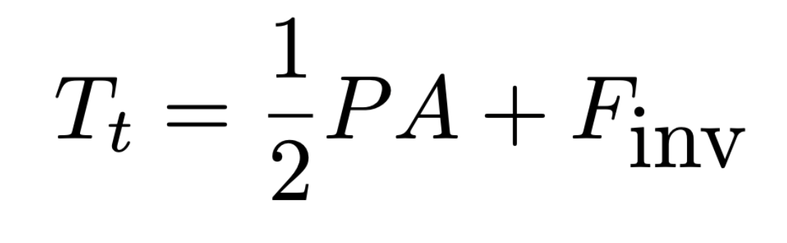
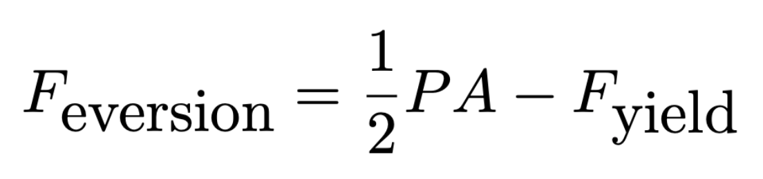
Basic Models
Tension to retract is:
(Coad et. al.)
In growth, tip applies force to inner material:
(Blumenschein et. al.)
Introduction
Modeling
Prototype 1
Testing Results
Conclusion

Slide 16
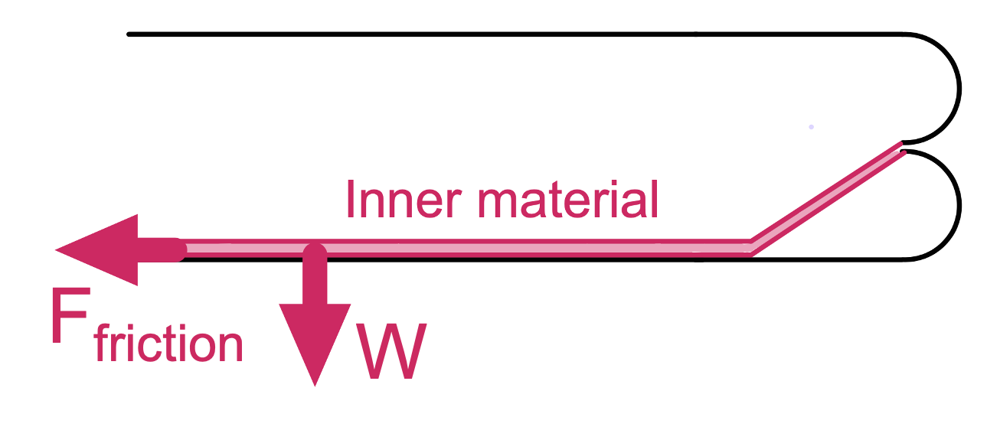
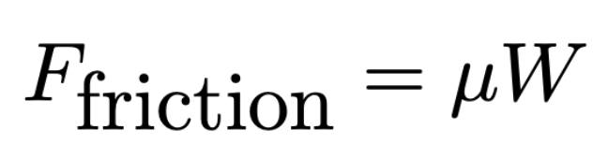
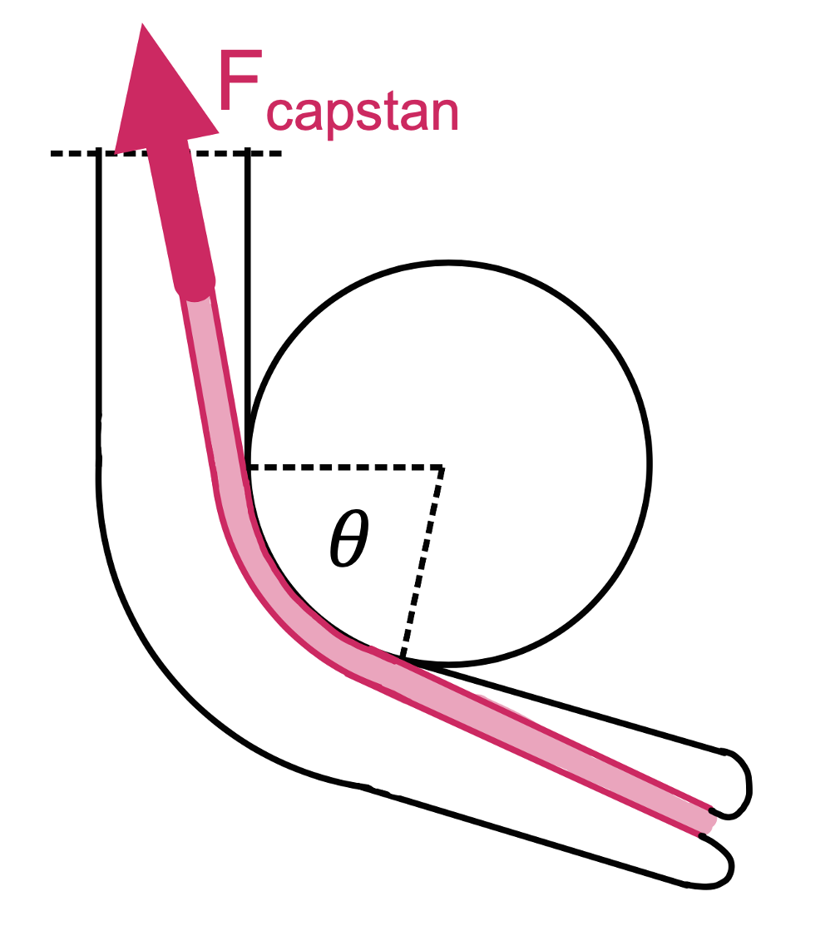
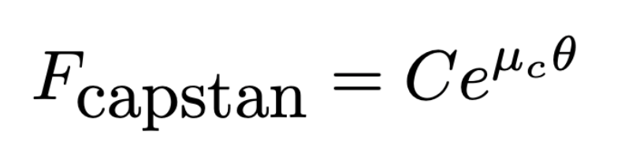
Incorporating Friction
Linear friction from dragging:
Capstan friction from turns:
(Blumenschein et. al.)
Introduction
Modeling
Prototype 1
Testing Results
Conclusion

Slide 17
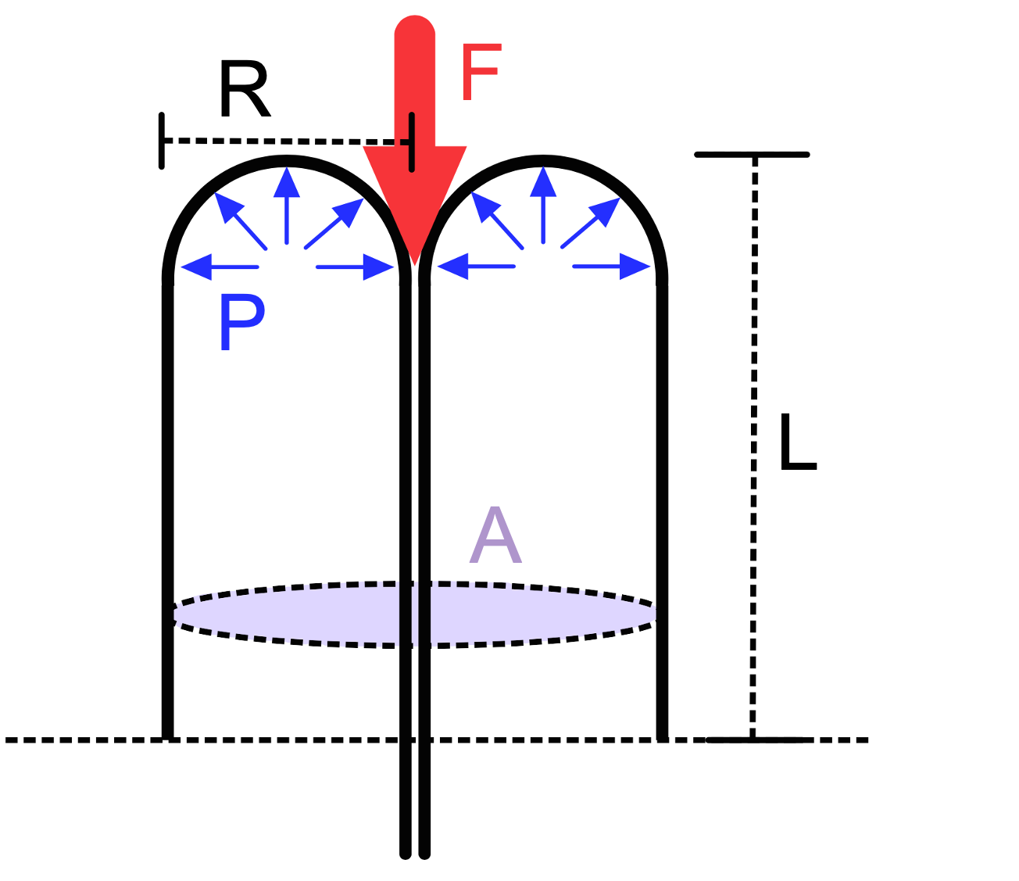
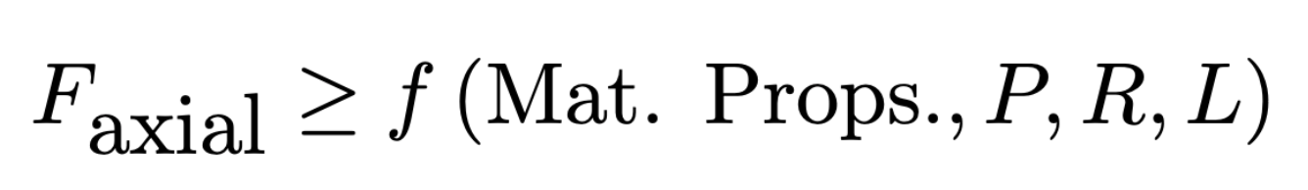
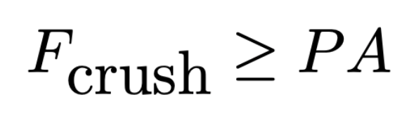
Buckling Modes
Axial buckling:
Crushing:
(Coad et. al.)
Introduction
Modeling
Prototype 1
Testing Results
Conclusion

Slide 18
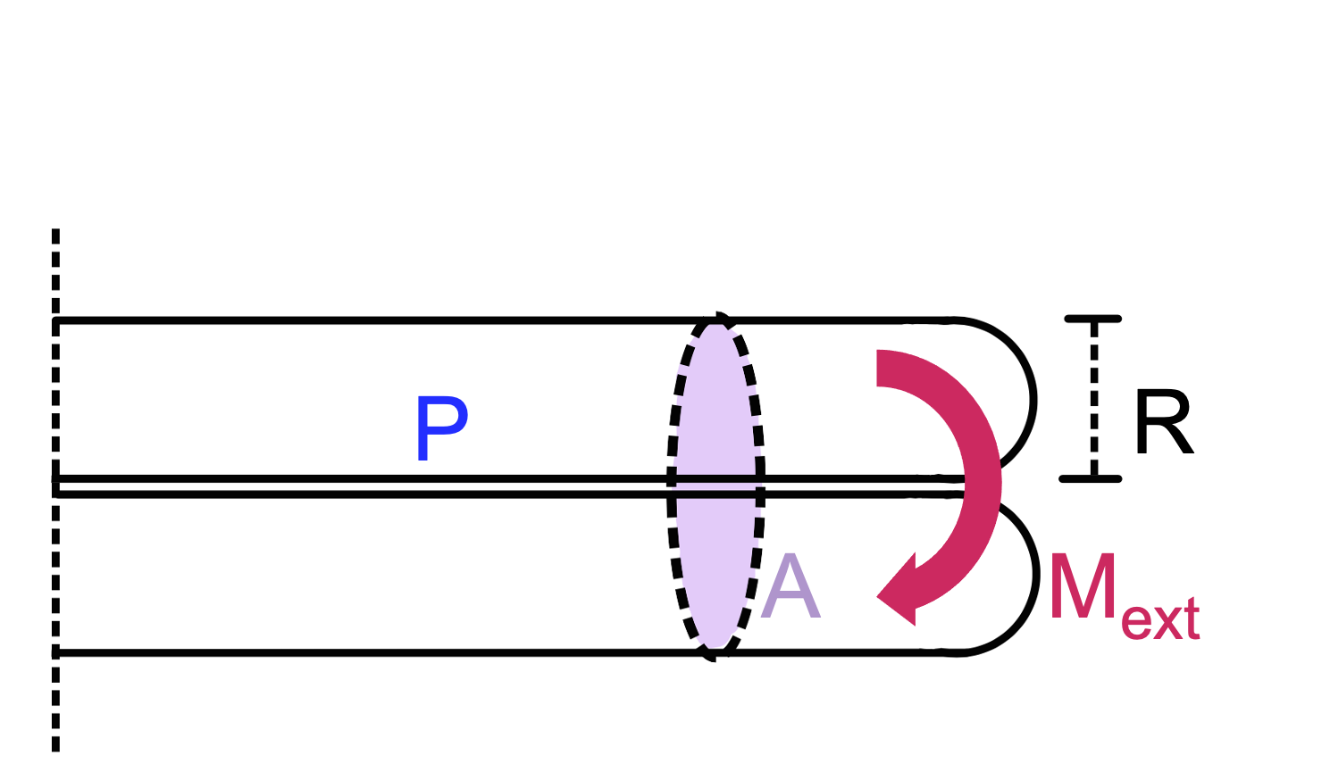
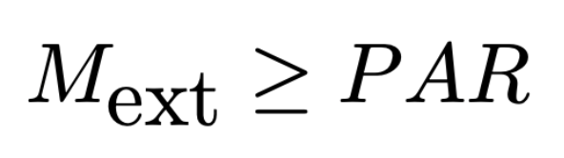
Buckling Modes - cont.
Transverse buckling:
(W. B. Fichter)
Introduction
Modeling
Prototype 1
Testing Results
Conclusion

Slide 19
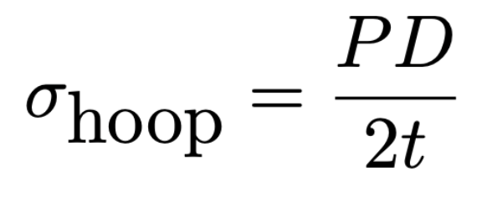
Failure Modes
Once minimum pressures to grow or retract without buckling are known, determine:
  Tensile stress in tail
    Determined by force needed to pull material to tip or pull material to base station
  Hoop stress
    Determined by pressure inside vine robot
Introduction
Modeling
Prototype 1
Testing Results
Conclusion

Slide 20
Presentation Structure
Introduction
Modeling
Prototype 1
Testing Results
Conclusion
Introduction
Modeling
Prototype 1
Testing Results
Conclusion

Slide 21
Prototype Rationale and Planning
Prototype Objective:
Inform and validate growth and retraction models as a test platform
Serve as a proof-of-concept or testing platform for:
  Base station architecture
  Robot body material selection
  Fabrication
Introduction
Modeling
Prototype 1
Testing Results
Conclusion

Slide 22
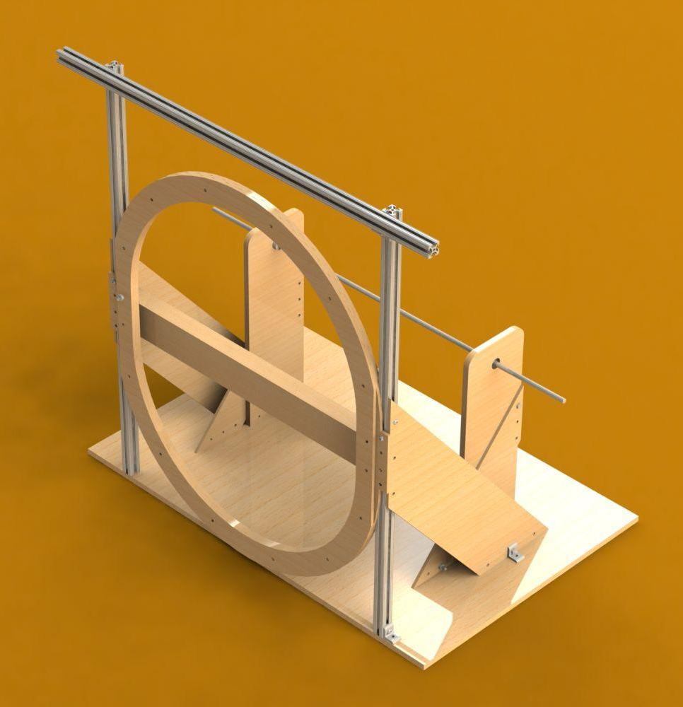
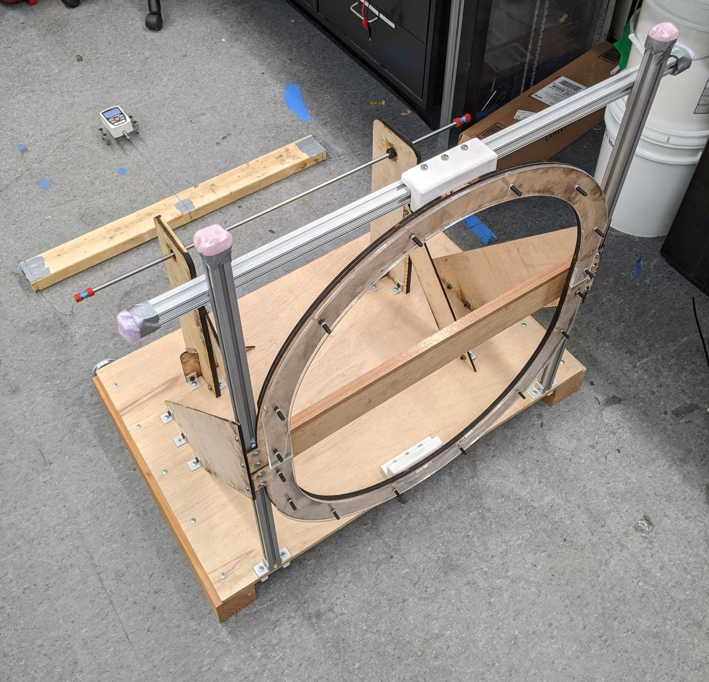
Prototype Design and Fabrication
Spool for body
(Al shaft)
Frame and supports
(laser cut, 8020 bars)
Sealing ring
(laser cut)
Design goals:
Enable easy access to the interior of the robot
Reliably seal the robot body to the base station
Design lessons:
Increase stiffness
Make more modular by using robust fasteners
Introduction
Modeling
Prototype 1
Testing Results
Conclusion

Slide 23
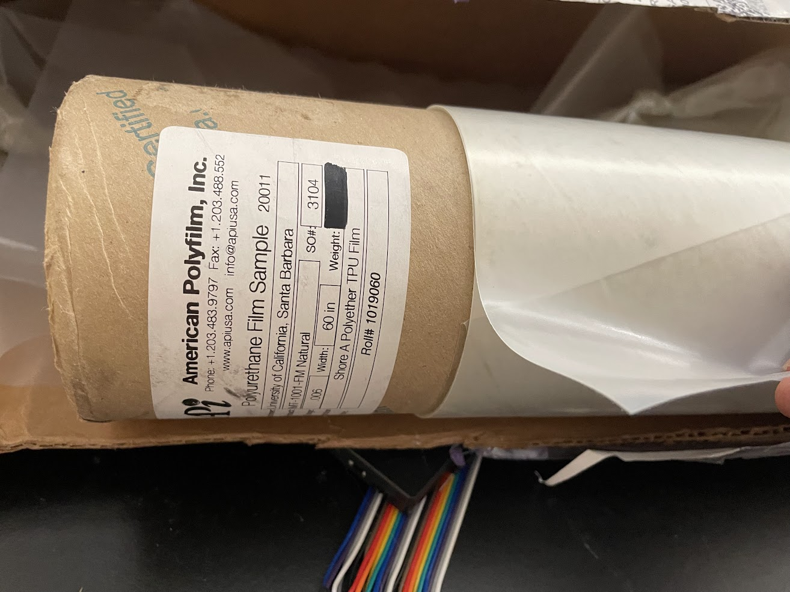
Material Selection
Options
Thermoplastic polyurethane (TPU)
Silicone-coated nylon (Sil-Nylon)
Low density polyethylene (LDPE)
We chose TPU because:
Higher resilience than LDPE
Can be heat sealed (Sil-Nylon requires silicone epoxy to bond)
Reasonably low friction material
Introduction
Modeling
Prototype 1
Testing Results
Conclusion

Slide 24
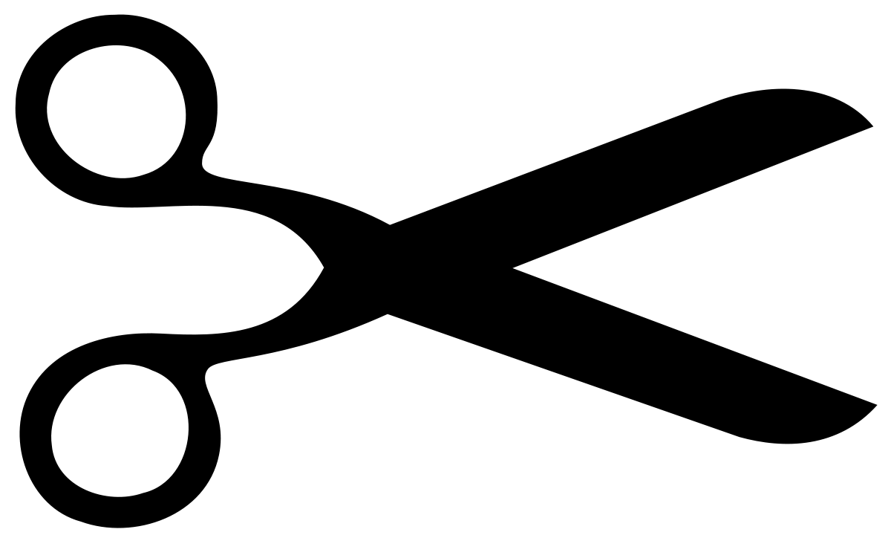
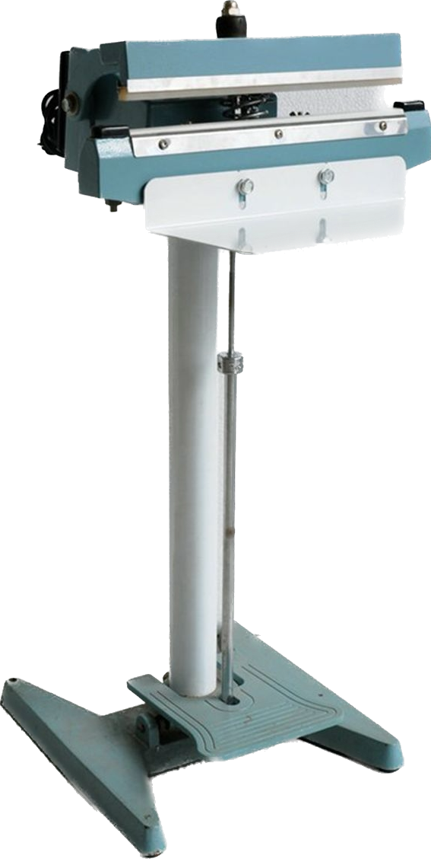
Prototype 1 Vine Robot Fabrication Procedure
Vine Robot Body Fabrication
Fold
Heat seal edge and end
Final result
Vine Robot Base Interface (Skirt)
Cut wedges
Heat seal robot body to skirt
Top View
Side View
Pressure
permanent seal
90 °C
Introduction
Modeling
Prototype 1
Testing Results
Conclusion

Slide 25
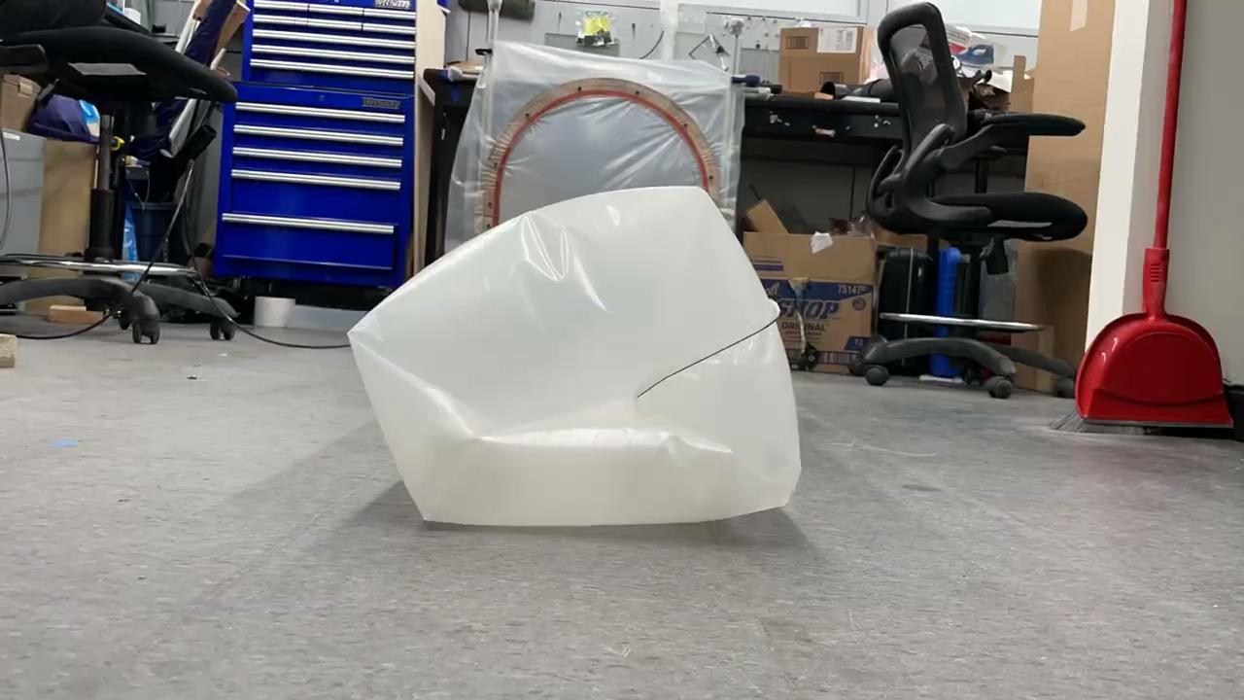
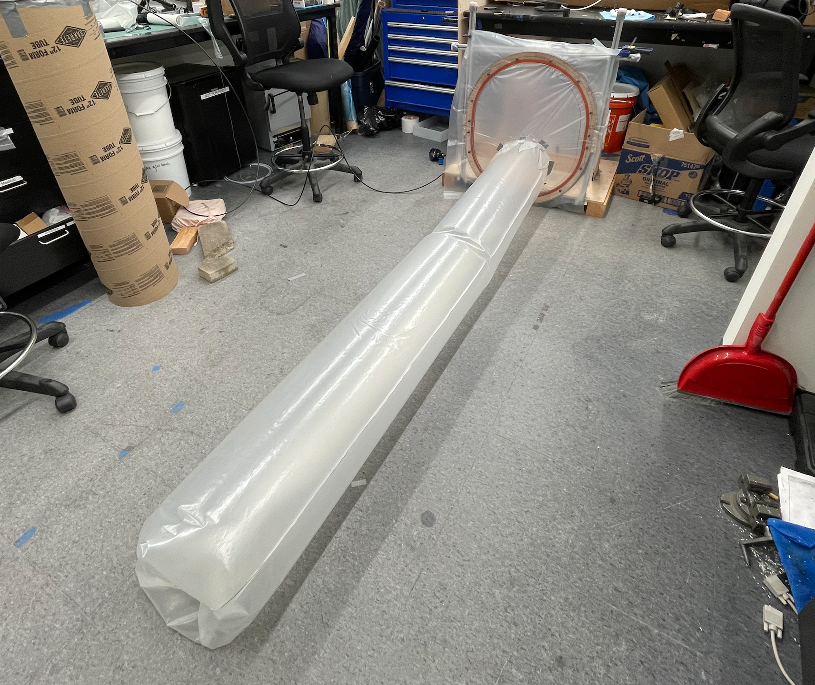
Prototype 1
Base station
Vine robot body
Tip growth
Introduction
Modeling
Prototype 1
Testing Results
Conclusion

Slide 26
Presentation Structure
Introduction
Modeling
Prototype 1
Testing Results
Conclusion
Introduction
Modeling
Prototype 1
Testing Results
Conclusion

Slide 27
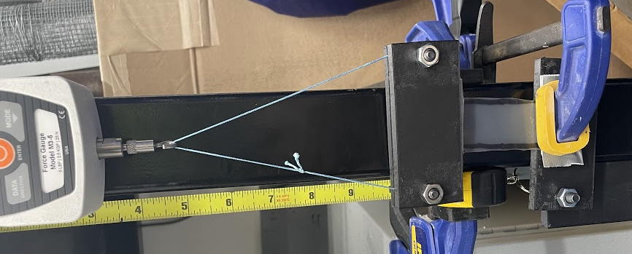
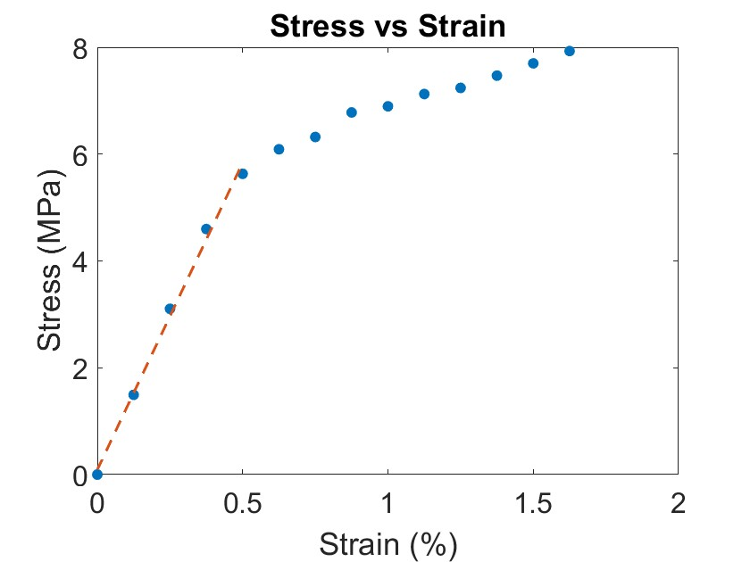
TPU Material Properties
Test Design
Clamp, force gauge, and ruler
Video recording
Test Deliverables
Obtain yield stress, Young’s modulus
Yield stress: 6.27±0.5MPa
Yield stress (T-Joint): 5.01 ±0.07MPa
Introduction
Modeling
Prototype 1
Testing Results
Conclusion

Slide 28
Prototype Testing: Methods and Procedures
1) Growth Testing
Deriving: yield force, linear friction force
Length
Pressure
2) Retraction Testing
Deriving: inversion force
Retraction Force
Pressure
3) Unconstrained Buckling Testing
Deriving: critical buckling pressure
Unsupported length
Mg
Pressure
Angle
Introduction
Modeling
Prototype 1
Testing Results
Conclusion

Slide 29
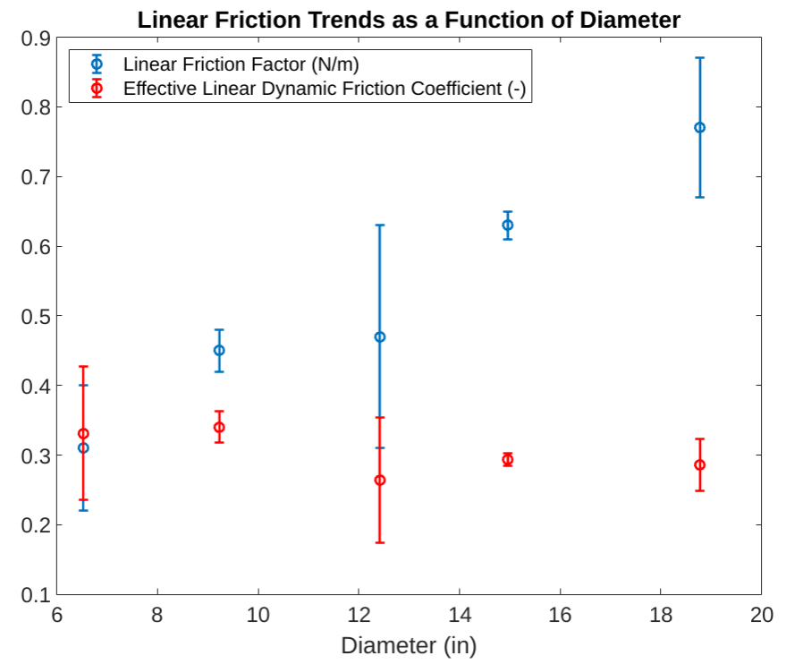
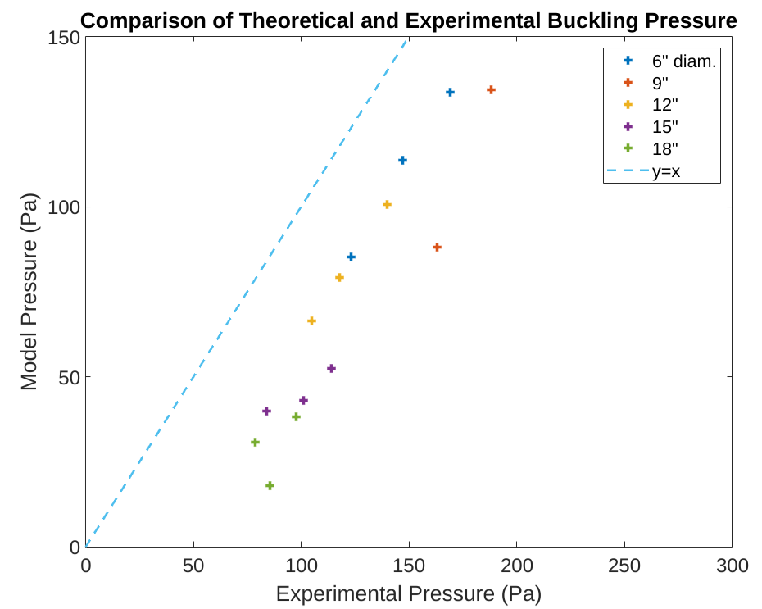
Prototype Testing: Linear Friction and Buckling Results
The friction force (per length) increases with robot diameter
Experimental trends agree with the predicted buckling behavior
Introduction
Modeling
Prototype 1
Testing Results
Conclusion

Slide 30
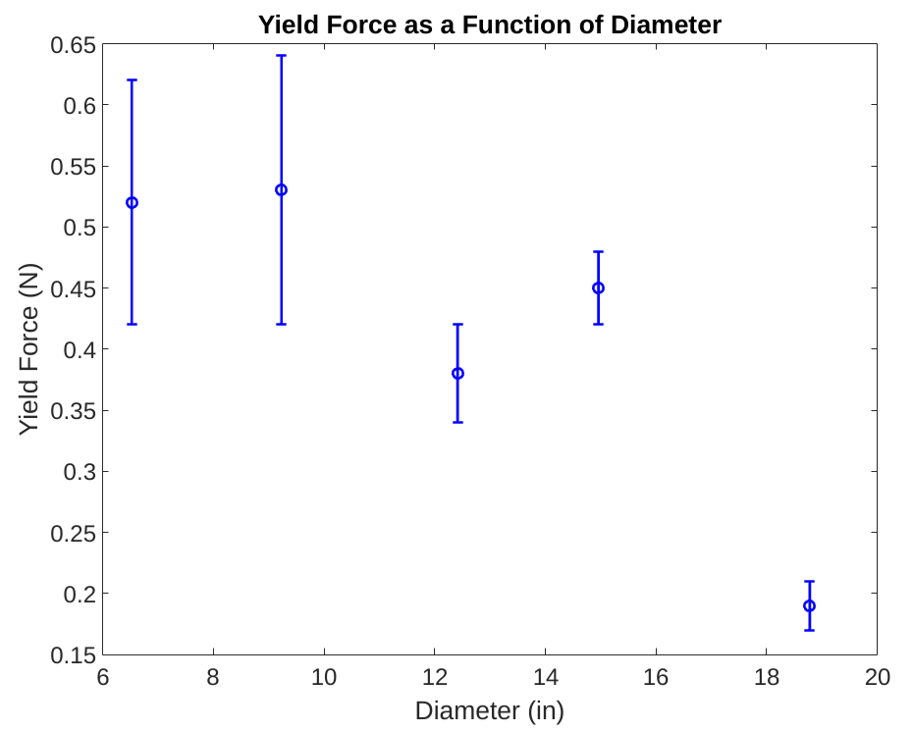
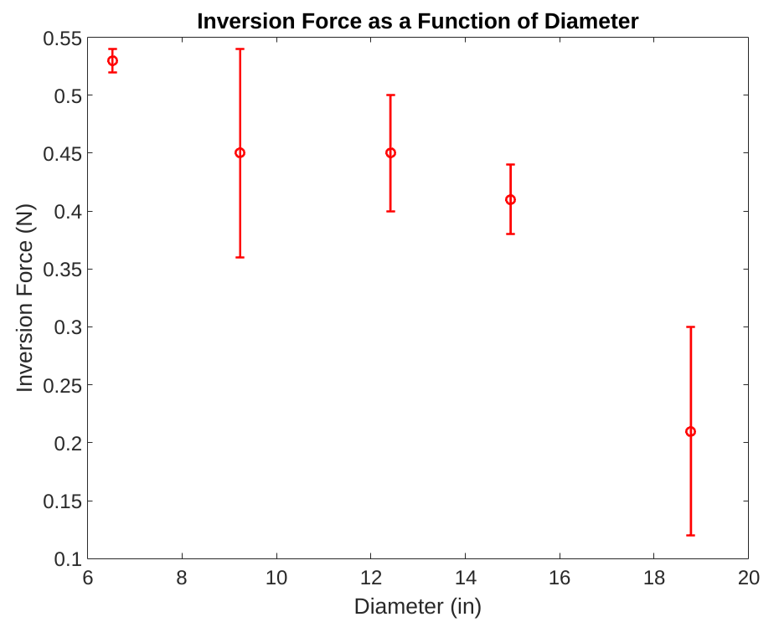
Prototype Testing: Yield and Inversion Force Results
The results indicate that both the inversion force and the yield force may decrease as the robot diameter increases
Introduction
Modeling
Prototype 1
Testing Results
Conclusion

Slide 31
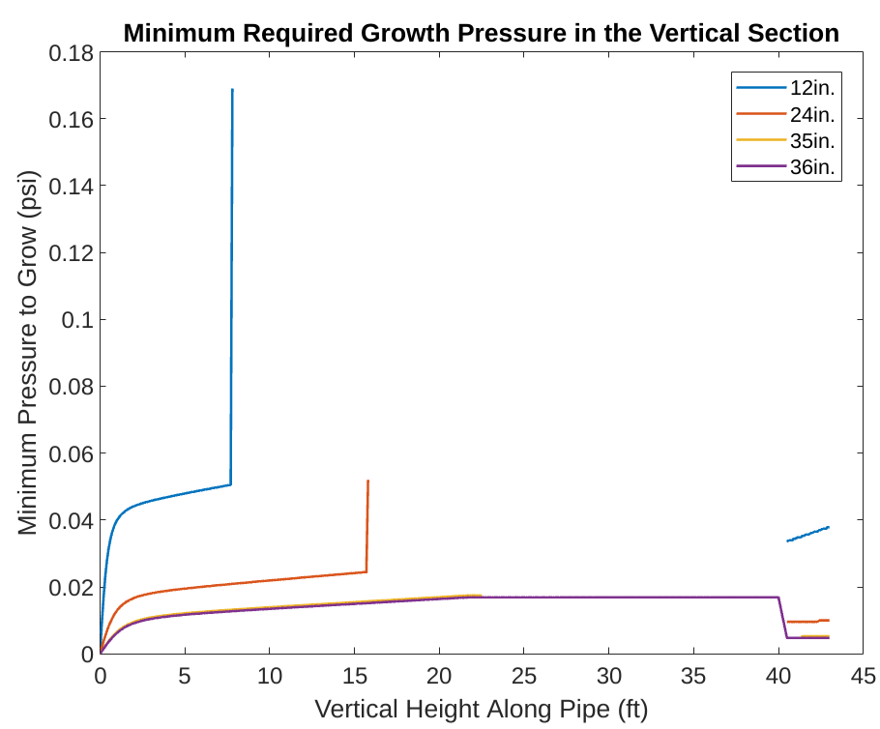
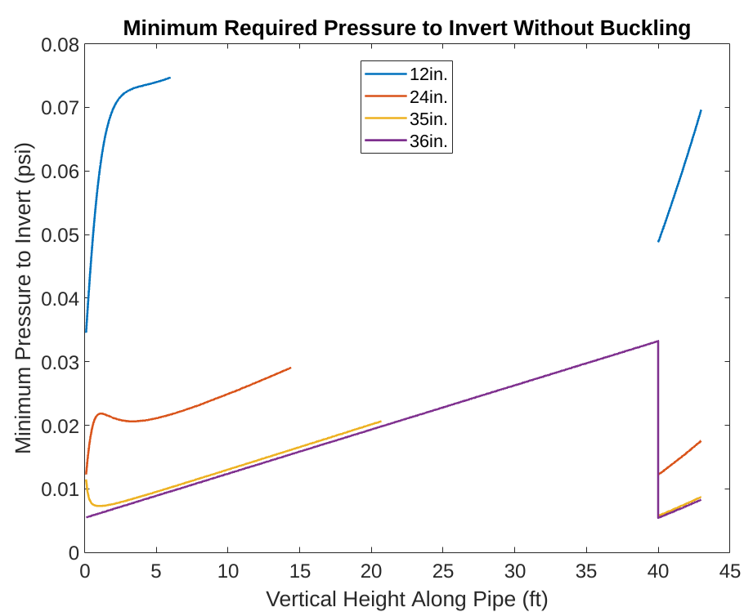
Initial Advanced Modeling (No Buckling)
When the minimum pressure leads to a safety factor < 1, no line is shown
Introduction
Modeling
Prototype 1
Testing Results
Conclusion

Slide 32
Analysis
Only full sized vine robot will work without any buckling
Sizes above ~24” may be feasible with multiple kinks
Introduction
Modeling
Prototype 1
Testing Results
Conclusion

Slide 33
Presentation Structure
Introduction
Modeling
Prototype 1
Testing Results
Conclusion
Introduction
Modeling
Prototype 1
Testing Results
Conclusion

Slide 34
Summary
Industrial pipe inspection is difficult
  Vine robots are promising
Analytical equations for various failure modes exist
  Derive hoop and tensile stress safety factors
Developed subsystem and characterization testing platform
Conducted initial characterization and modeling
Introduction
Modeling
Prototype 1
Testing Results
Conclusion

Slide 35
Future Work
Decide on vine robot diameter using:
  Additional modeling on vertical buckling
  Other parameters such as growth speed and device size/weight
Design and build prototype 2 using diameter selected
  Integrate tip mount, camera, communications, and teleoperation
Test at Bechtel Corp. facility and gather data on performance
Introduction
Modeling
Prototype 1
Testing Results
Conclusion

Slide 36
Thank You
Vine Robots for Industrial Inspection
Fall 2022 Final Presentation

Slide 37
Works Cited
[1] L. H. Blumenschein, A. M. Okamura, and E. W. Hawkes, “Modeling of bioinspired apical extension in a soft robot,” in Living Machines, 2017.
[2] M. Coad, R. Thomasson, L. Blumenschein, N. Usevitch, E. Hawkes, and A. Okamura, “Retraction of soft growing robots without buckling,” 10 2019.
[3] Fichter, W. B. “A Theory for Inflated Thin-Wall Cylindrical Beams.” Google Books, National Aeronautics and Space Administration, https://books.google.com/books/about/A_Theory_for_Inflated_Thin_wall_Cylindri.html?id=qav9mWWlb-AC.

Slide 38
Bonus Slides

Slide 39
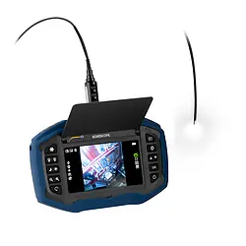
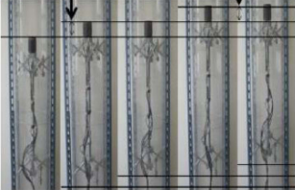
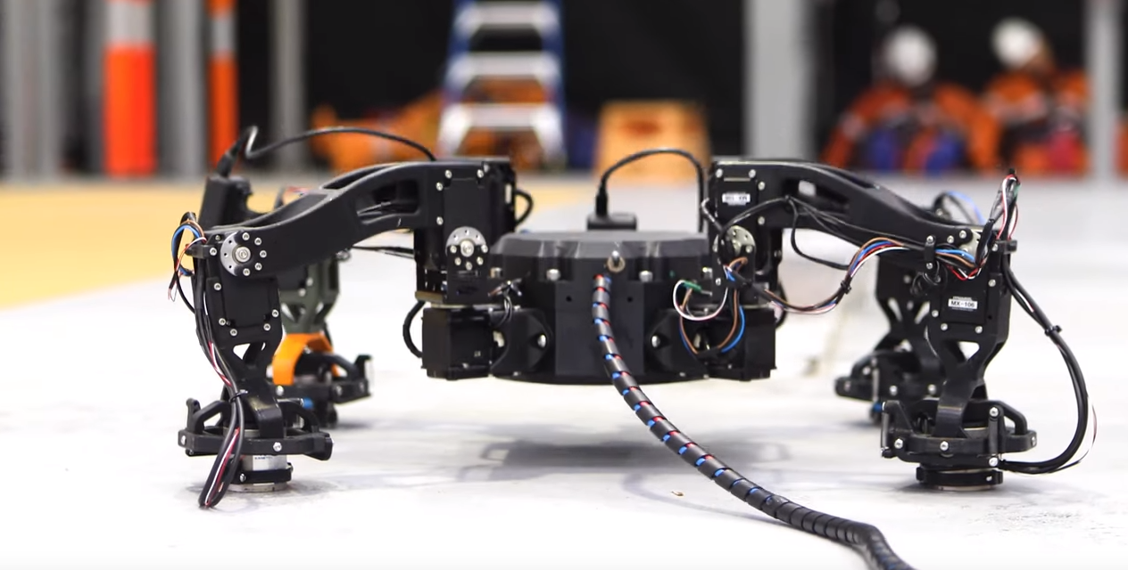
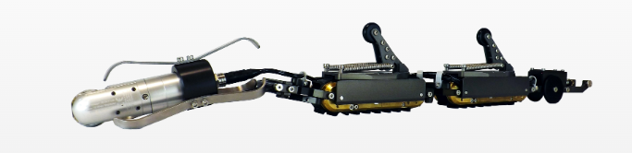
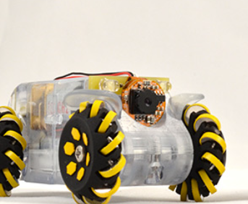
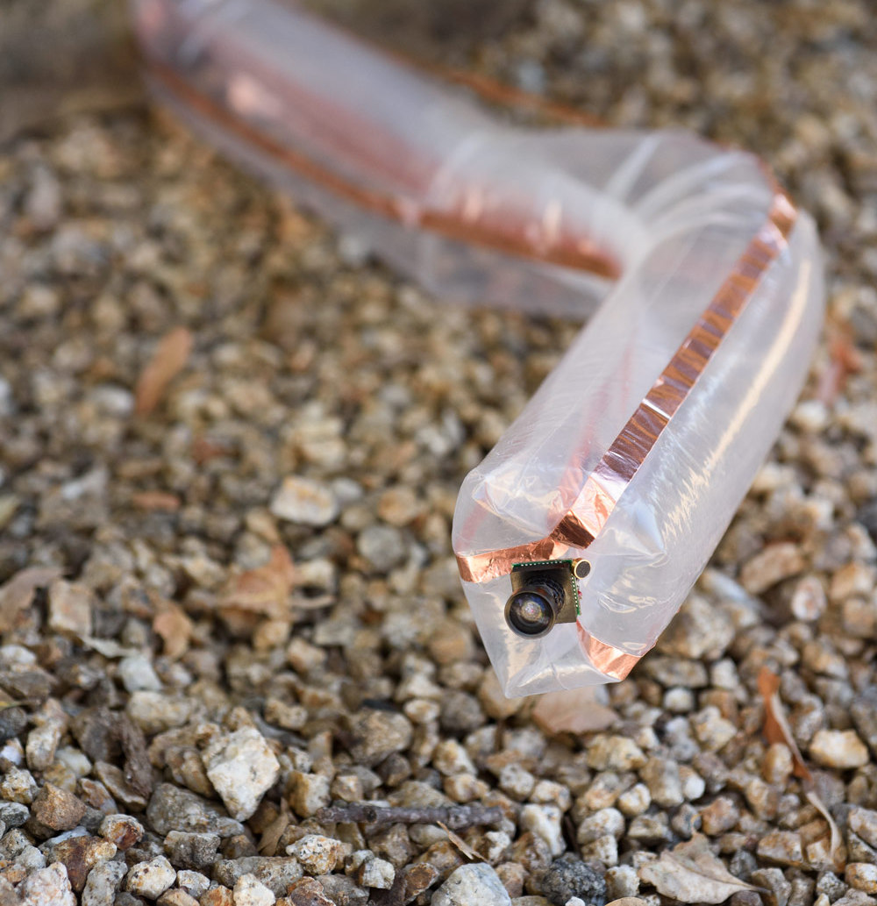
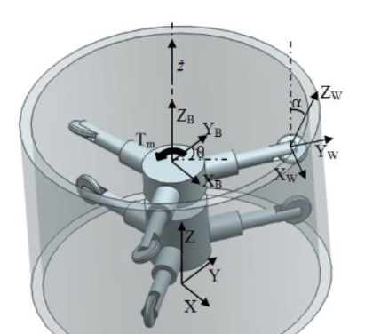
Detailed Product Review
PCE Instruments
Inspection Robots
Borescopes
InspectorX GmbH
Wheeled Robot
Tracked Robots
Pneumatic-drive Robots
Mechanism-driven Robots
Aerial Drones
Fiberscope
Eddify Technologies
Yoon et. al, 2010.
Nexxis
Efficient propulsion: High area generates large pneumatic forces, tip eversion minimizes friction.
Agility: Can navigate bends/blockages/vertical/
un-constrained sections without complex rigid mechanisms.
Scalability: Easy to adapt to different ranges of pipes with a change of body.
Cost: Due to mechanical simplicity, cost estimates are lower than commercial counterparts.
Durability: Not affected by fluids, high temperature environments, and obstacles.
Regular Wheel
Fixed Track
Inchworming Robots
Legged Robots
Mecanum or Magnetic Wheel
Variable Width Track
Vine Robot
Screw-drive Robots
Honeybee Robotics
In-pipe Robotics
Image: L.A. Cicero, Stanford University
Nayak et. al. 2014

Slide 40
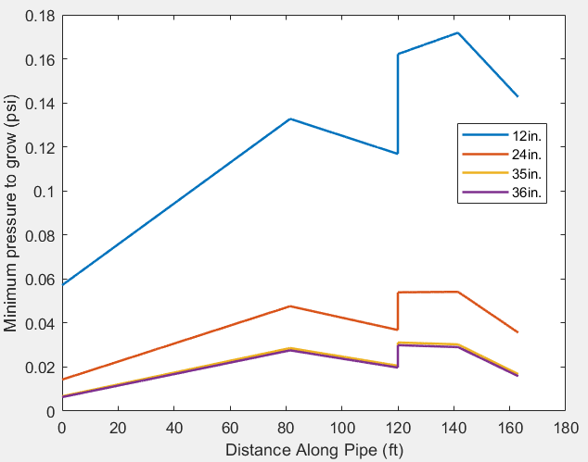
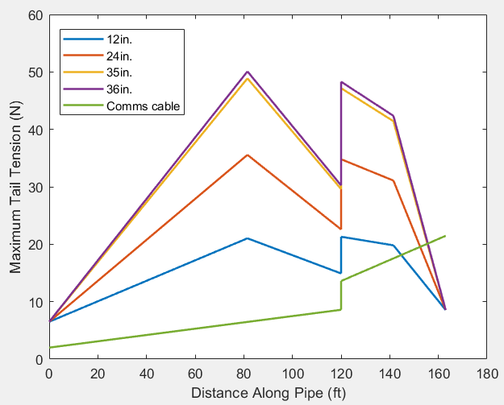
Pressure and Tension Modeling

Slide 41
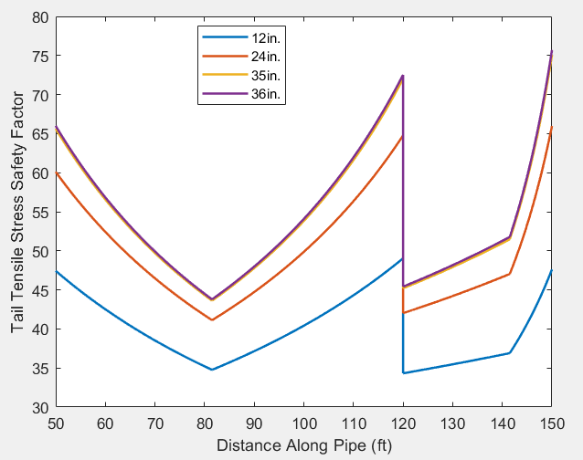

Safety Factors

Slide 42

Safety Factors Cont.

Slide 43

Risk Analysis

Slide 44
Slide 10: Prototype 1 Material Selection
Desired material properties and candidates
Procurement challenges
Material Selection
Procurement / Properties TPU
American Polyfilm Inc. (Supplier)
  Hydrolysis Resistant.
  Strong resistance to impact, abrasions, and tears
  Recyclable
Rationale
Thermoplastic Polyurethane (TPU) is “the bridge between rubber and plastic”
Has been used for previous vine robots.
Recommended to us by Professor Hawkes.
The team created an analytical model to estimate the Safety Factor of a potential vine burst for our use case
  This model requires yield data of TPU.
  An experiment was designed to determine yield stress
TPU sample from supplier

Slide 45


Prototype 1 Tip Mount
Designed to mount camera system to the front of the vine robot.
Small scale tip mounts have been deployed by other researchers.
Challenges:
  Tip mount weighs down the nose of the robot.
  Robot grows through the tip mount as opposed to pushing it along.

Slide 46
Slide 12: Prototype 1 Communications
Requirements for communication
Different options explored
Outcome, ongoing efforts, and future plans.
Prototype 1 Communications (Bonus Slide)
Requirements
Wired connection from tip to base
Low Latency live video transmission
Options
Wireless Protocol: RF (Analog), WiFi (Digital)
Wired Communication: Ethernet, USB, Analog Video, HDMI
Camera: Drone Cam, IP Cam, Action Cam
Outcome
Amcrest IP camera (wireless) to Wi-Fi router (Ethernet cable) to computer at the base
Raspberry Pi with pressure sensor (wireless) to Wi-Fi router to computer at base
Future Plans
Investigate various methods of video transmission to find the most optimal live view options

Slide 47

Slide 13: Prototype 1 User Interface and Sensing
Requirements for UI
Different options explored
Outcome, ongoing efforts, and future plans.
User Interface and Sensing
Python, PyQT module
Displays live camera, pressure data

Slide 48

Detailed Base Station Testing Results
Moving average used to compute the pressure over time

Slide 49
Detailed Base Station Testing Results Cont’d
Diameter (m) | Yield Force (N) | Inversion Force (N) | Friction Factor (N/m) | Tail Mass (kg/m) | Normal Force (N/m) | Friction Coefficient mu | Density (kg/m^3)
0.48 | 0.19 | 0.21 | 0.77 | 0.27 | 2.69 | 0.29 | 1201.40
0.38 | 0.45 | 0.41 | 0.63 | 0.22 | 2.14 | 0.29 | 1201.40
0.32 | 0.38 | 0.45 | 0.47 | 0.18 | 1.78 | 0.26 | 1201.40
0.23 | 0.53 | 0.45 | 0.45 | 0.13 | 1.32 | 0.34 | 1201.40
0.17 | 0.52 | 0.53 | 0.31 | 0.10 | 0.94 | 0.33 | 1201.40
Standard Deviations | Yield Force (N) | Inversion Force (N) | Friction Factor (N/m)
0.48 | 0.02 | 0.09 | 0.1
0.38 | 0.03 | 0.03 | 0.02
0.32 | 0.04 | 0.05 | 0.16
0.23 | 0.11 | 0.09 | 0.03
0.17 | 0.1 | 0.01 | 0.09
Summary of results for different robot body diameters

Slide 50

Capstan Friction Testing

Slide 51
Bonus 5: Detailed Material Testing Results
Fixture design and more results from Raj
Detailed Material Testing Data
Original Material | Trial 1 | Trial 2 | Trial 3 | Trial 3 Alt | Avg | STDEV
Yield Strength (MPa) | 6.14 | 6.49 | 5.66 | 6.82 | 6.27 | 0.50
Elongation at Yield | 0.50 | 0.50 | 0.50 | 0.75 | 0.56 | 0.13
Ultimate Tensile Stress (MPa) | 7.70 | 7.93 | 7.35 | 7.35 | 7.58 | 0.28
Ultimate Tensile Strain (%) | 1.63 | 1.63 | 1.75 | 1.75 | 1.69 | 0.07
Young’s Modulus (MPa) | 10.80 | 11.50 | 9.84 | 8.11 | 10.06 | 1.47
T-Joint | Trial 1 | Trial 2 | Trial 3 | Avg | STDEV
Yield Strength (MPa) | 4.94 | 5.05 | 5.05 | 5.01 | 0.07
Elongation at Yield | 0.66 | 0.48 | 0.48 | 0.54 | 0.10
Ultimate Tensile Stress (MPa) | 5.18 | 6.20 | 7.36 | 6.25 | 1.09
Ultimate Tensile Strain (%) | 0.99 | 1.45 | 2.24 | 1.56 | 0.64
Young’s Modulus (MPa) | 7.19 | 9.13 | 9.19 | 8.50 | 1.14

Slide 52


Diameter Characterization
Purpose: Figure out the footprint of 160 ft long vine robot stored on a spool.
Diameter of a spooled length of material can be estimated using the thickness of the material itself.
We must however account for packing inefficiencies
D₁ = 0.022 (Initial Thickness of TPU film)
Diameter Column | Circumference Column
D₁ | D₁𝛑
(1,1) + D₁ | (1,2) + (2,1)𝛑

Slide 53

Unconstrained Buckling Model
Tip Mount
Unconstrained buckling
  Model as transverse
Moment balance
Tip Mount Weight
Body Weight
Tail Tension
Wall Normal Force

Slide 54


Constrained Buckling Model
Wall normal force
Tip Mount
Constrained buckling
  Axial
Wall friction
Tip Mount Weight
Wall normal force
(W. B. Fichter)
Body Weight
Wall friction

Slide 55


Unconstrained Buckling Validation

